Slide 1
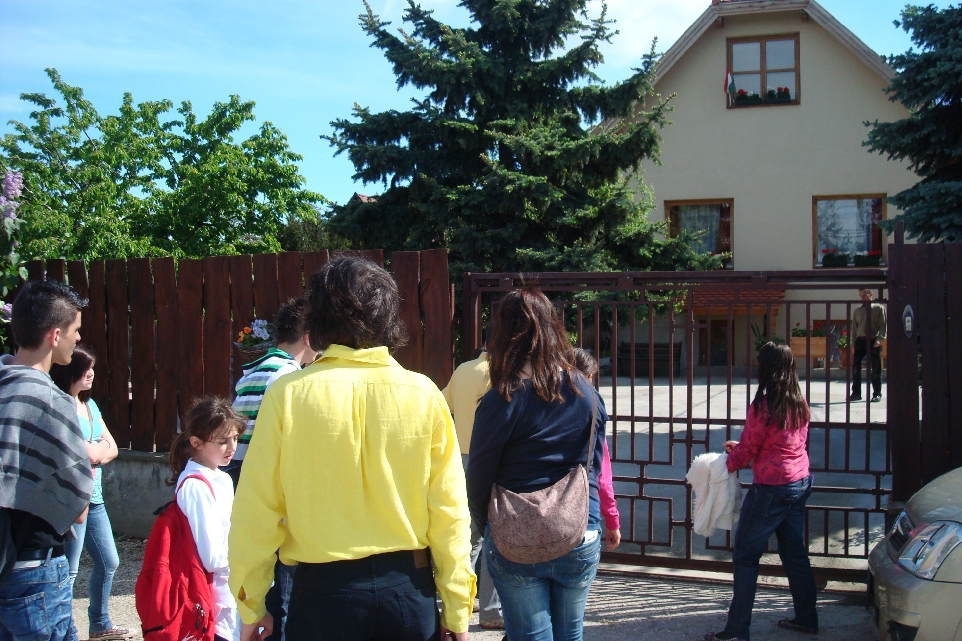
Traditional hungarian house

Slide 2
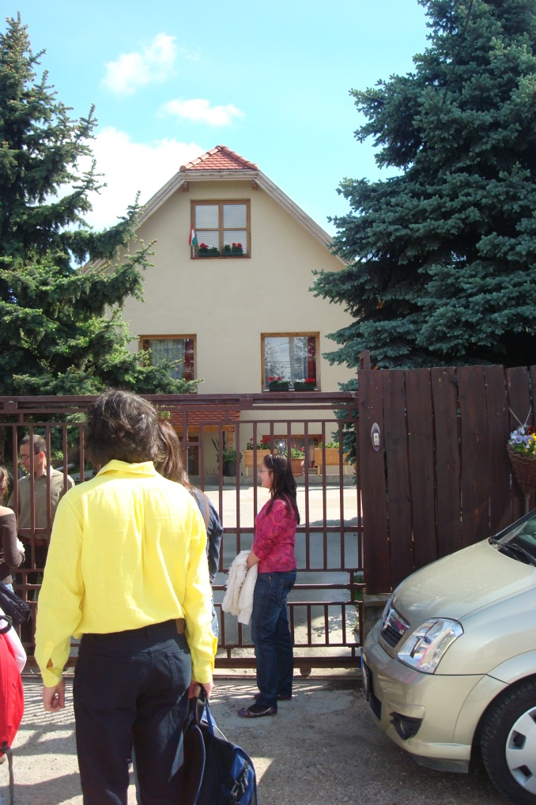
İNFORMATİON ABOUT THE HOUSE
5 years ago it was built
The house before was smaller
5 people live here
Two dogs live there but no cats
This house is hungarian traditional especially inside
The house is built with bricks and wood
There are 5 big rooms
Expensive house because the place is near Budapest
Out present a beautiful park

Slide 3
Kitchen

Slide 4
we in in the living room

Slide 5
oven

Slide 6
The mother with her baby

Slide 7
The place where his wife works

Slide 8
One of the two dogs which live in the house

Slide 9
Particular structure whereby building the roof

Slide 10
This house was built with the pleasure of god in 2005

Slide 11
Corridor which connects the two rooms at the second floor

Slide 12
bathroom

Slide 13
The room where the children enjoy

Slide 14
The garden

Slide 15
Our card for the house owners

Slide 16
Our card for the house owners

